Slide 1
Welcome! We will be starting soon.
Examination for Professional Practice in Psychology (EPPP) Virtual Town Hall Meeting
Individuals can choose to add captions by selecting the Show Captions
button below

Slide 2

Presenters
Jennifer C. Laforce, PhD, CPsych
President-Elect ASPPB Board of Directors
Dr. Jennifer C. Laforce, C.Psych., is a respected psychologist with extensive experience in clinical practice and leadership within the field of psychology. She has been a Registered Psychologist since 2007, initially with the University of Manitoba then in full-time private practice with a focus on clinical assessment and treatment services for adults with trauma-related conditions, depression, anxiety, and addictions. As president-elect of ASPPB, Dr. Laforce is passionate about promoting best practices in professional psychology and ensuring the integrity and effectiveness of regulatory standards across North America.

Slide 3

Presenters
Hao Song, PhD, ICE-CCP
Associate Executive Officer of Examination Services
Dr. Hao Song, PhD, ICE-CCP, is the Associate Executive Officer of Examination Services at the Association of State and Provincial Psychology Boards (ASPPB), where she leads the operations, development, and continuous improvement of key licensing exams, including the Examination for Professional Practice in Psychology (EPPP) and the Psychopharmacology Examination for Psychologists (PEP). In her role, Dr. Song spearheads innovative research and technology applications related to credentialing assessments and ensures the quality and validity of large-scale professional licensing programs.

Slide 4
EPPP Virtual Town Hall Meeting for Students, Post-docs, and Candidates
Welcome
Three big questions about the EPPP
Dr. Jennifer Laforce
Updates on developing an integrated exam
Dr. Hao Song
Questions and Comments
Raise Your Hand to ask a question verbally
Type your question in Q&A
Check the box if you wish to show as anonymous
Individuals can choose to add captions by selecting the Show Captions
button below

Slide 5
EPPP Virtual Town Hall Meeting for Students, Post-docs, and Candidates
If you have further comments
or would like a copy of today’s slides
EPPPcomments@asppb.org
Individuals can choose to add captions by selecting the Show Captions
button below

Slide 6
Three big questions about
the EPPP
Where DO the items come from?
But isn’t it going to change?
How can I know what is covered?
Jennifer C. Laforce, PhD, CPsych
Chair, EPPP Collaborative Implementation Task Force
President-Elect, ASPPB Board of Directors

Slide 7
What brings you here today?

Slide 8
Grad School
Supervised Hours
Licensed in a Jurisdiction
Independent Practice
EPPP

Slide 9
EPPP
Examination for Professional Practice in Psychology
Licensure exam was launched in 1965 as a standardized way to assess foundational knowledge in psychology
Public protection at the threshold of independent practice
Common across 66 jurisdictions in the USA and Canada

Slide 10
Where do the items come from?

Slide 11
Care that goes into crafting an item
Individual drafts item
All domain writers gather to refine all items
Pretest
Blueprint specifications
Review statistics
Operational item bank
Item selected for exam form
Independent Exam Committee review
Exam Form Live
Lifecycle of an EPPP item

Slide 12
Processes to ensure validity
Standard Setting
7-10 years
Job Task Analysis
7-10 years
Item and Test Analyses
Fairness Review
Every Form
Notes:
Licensing exams are only part of process that can be legally defended
Diff– do not want items that capturing variance unrelated to what you are testing

Slide 13
What you don’t see in the graphics are the people

Slide 14
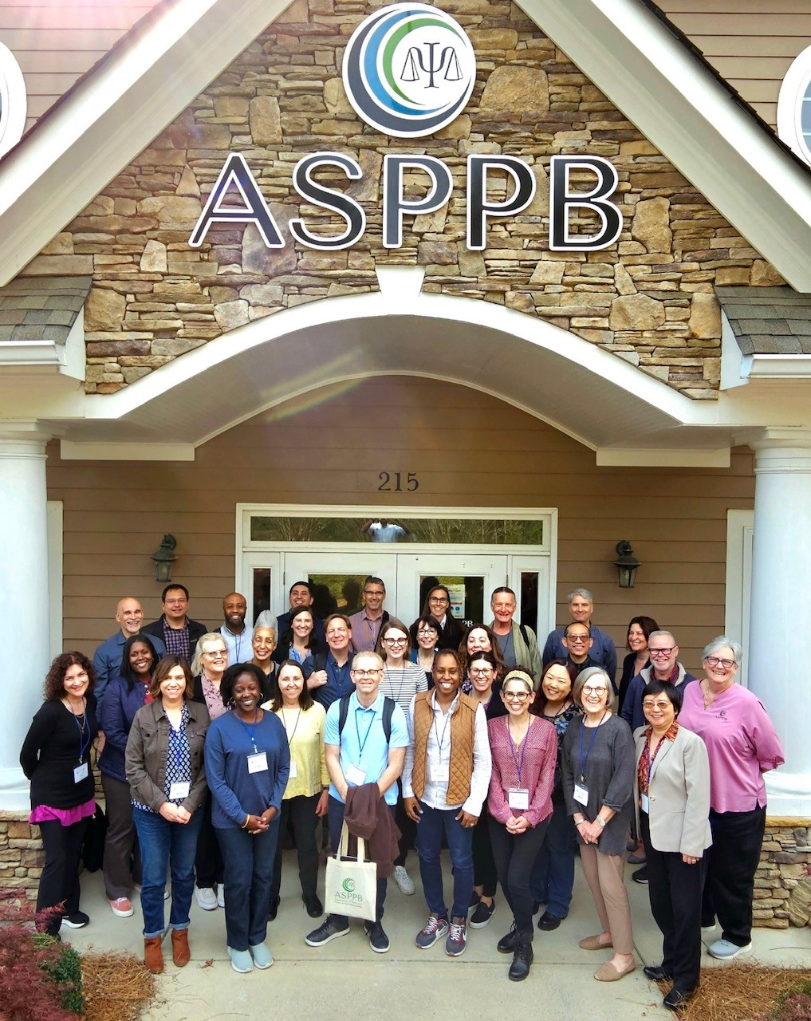

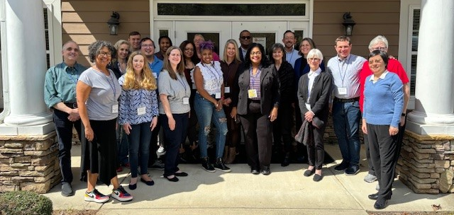


Slide 15
Each person who touches an item is considering
Can the wording be simplified?
Is this entry-level knowledge or skills?
Does this apply across all jurisdictions?
Is this trailing-edge content?
Is this free of stereotypes in all aspects?
Does the item contain content that will be interpreted differently by certain groups?

Slide 16
But isn’t it going to change?

Slide 17

EPPP is Dynamic and Evolving
Every Year
500-600 items created
Two new forms created
Four exam forms are live at any time
Notes:
1/3 never make it to an operational form

Slide 18
The EPPP will recognize that competence
is more than foundational knowledge
In the 2000s everyone (educators, trainers, program accreditors, regulators) was talking about how competence is more than knowing facts
2008 ASPPB starts developing a skill-based part to the EPPP
Until last year, ASPPB had been working towards delivering the EPPP in two parts, one part focused on knowledge and one on skills
As we got closer to the point of implementation, increasing concerns about the impact of administering two parts
Oct 2024 ASPPB decided to move towards an integrated exam

Slide 19
What this move to an integrated EPPP means
It is the EPPP. The name will not change.
Exam will be designed to be taken at one sitting
Remain committed to assessing competence as including knowledge and skills
Committed to maintaining the high standard of test development, including existing checks and modification processes, that are integral to the EPPP
Have started the technical integration of the blueprints
true integration, not mechanical stacking

Slide 20
How can I know what is covered?

Slide 21
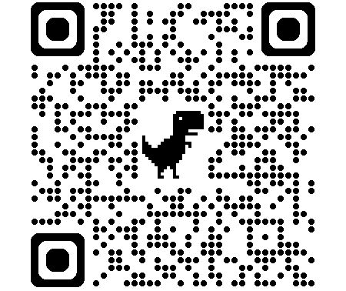
EPPP Blueprint
You can see what this looks like for the EPPP Parts 1 and 2 now
Content domains and knowledge statements/behavioral exemplars in each one
Relative weighting of content domains

Slide 22
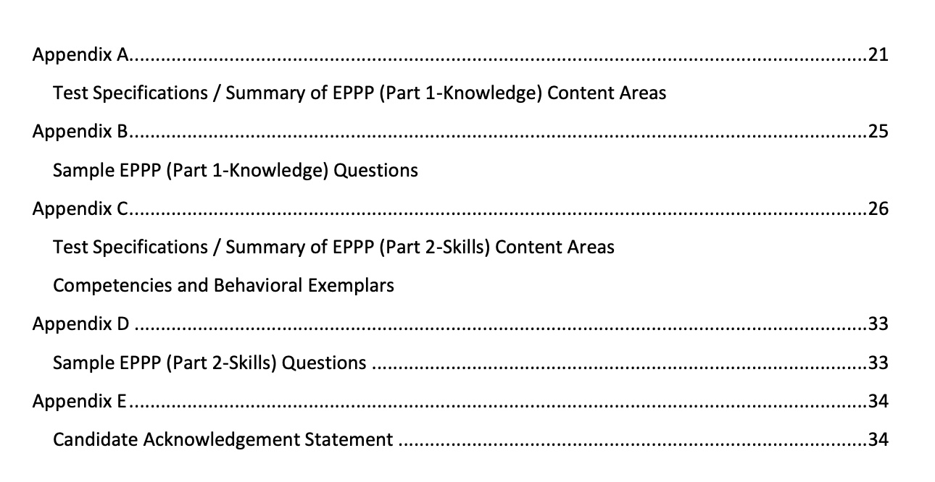

The EPPP Candidate Handbook

Slide 23
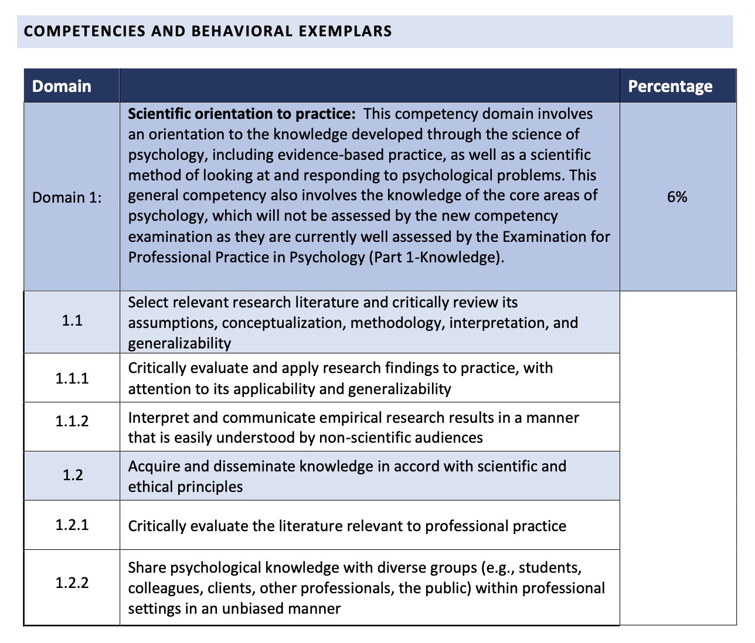
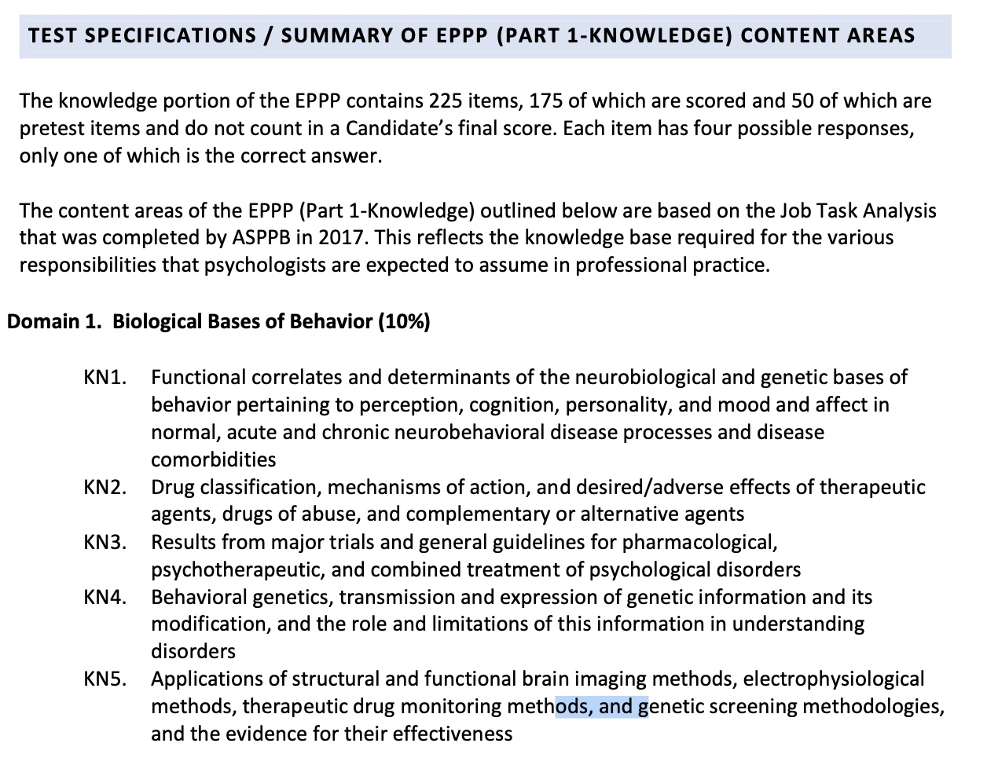
Notes:
Not just content areas and competencies and relative weighting
But also the specific knowledge statements and competencies

Slide 24
EPPP Blueprint
Item writers write to these statements
Determined by practicing psychologists’ ratings of frequency and importance
Whenever the blueprint changes, it is published at least least a year in advance.
the exact Content Domains and their relative weightings
the Competencies within a domain
the Knowledge and Skills within each Competency

Slide 25
Progress Updates on Developing an Integrated Exam
Hao Song, PhD, ICE-CCP
Co-Chair, EPPP Collaborative Implementation Task Force
Associate Executive Officer of Examination Services, ASPPB

Slide 26
Current EPPP exams are continued in development, maintenance, and delivery until the integrated EPPP is fully operational.
Job Task Analysis for Establishing Specifications for the integrated EPPP
Publication of the Integrated EPPP Blueprint; Development and Classification of Exam Items
Beta Testing and Setting Passing Standards of the integrated EPPP
Full Operation of the integrated EPPP
Formation and meetings of the EPPP Collaborative Implementation Task Force (CITF);
Quarterly Town Hall Meetings
Communicate with Regulatory Authorities, Education and Training Community about the
integrated EPPP
Recruitment of Participants; Continued Communication and UserX

Slide 27
EPPP Job Task Analysis
Job task analysis (JTA) is a systematic, documented process for obtaining information about the professional competencies of individuals with a credential or for whom a credential is designed.
Professional assessment programs conduct JTA periodically to ensure that the content specifications accurately reflect current practice.
Twenty out of 110 respondents to the call for volunteers serve on the EPPP JTA Task Force.
A survey on practice of psychology are being conducted in August-September.
The new exam blueprint will be published in Spring 2026.

Slide 28
A Possible Structure Integrating Assessment of Knowledge and Skills

Slide 29
Level 1: Content Domains
1. Scientific Orientation to Practice
2. Assessment
3. Intervention
4. Consultation and Supervision
5. Interpersonal Relationships
6. Ethical and Professional Practice

Slide 30
Level 2: Competencies within a Domain
2. Assessment
Demonstrate knowledge of psychometric principles and assessment methods
Integrate client characteristics when conducting assessments, differentially diagnosing, and providing feedback and recommendations
Administer, score, and interpret instruments, and synthesize findings across assessment methods, consistent with current guidelines and research
Formulate and communicate diagnoses, recommendations, and professional opinions considering all relevant findings and criteria

Slide 31
Level 3: Knowledge and Skills within a Competence
2.C.1. Administer, score, and interpret a range of frequently used standardized assessment instruments based on psychometric properties, available normed data and criterion-referenced standards, and address any limitations in the selection of instruments
2.C.2. Use relevant guidelines in situations requiring non-standard administration, scoring, and interpretation of assessment results
2.C.3. Interpret and synthesize results from various sources (e.g., multiple methods of assessment, written documentation, collateral sources of information) using relevant guidelines and research

Slide 32
Validation of the EPPP

Slide 33
Validity is Ensured Through Established Practices
• Subject Matter Experts (SME)
• Job Task Analysis
• Test Specifications
• Multiple Levels of Content Review
• Psychometric Evaluation
• Standard Setting
Methodology complies with guidelines from APA, AERA, and NCME.

Slide 34
EPPP and the Question of Bias
Published study suggested differential performance on demographic variables (Sharpless, 2019); readers’ inference contributes to the bias narrative
Differential performance ≠ Bias
Bias refers to construct underrepresentation or construct-irrelevant components of test scores (AERA, APA & NCME, 2014)
Differential performance could be from impact of many factors
Additional investigation is needed to determine whether bias exists

Slide 35
Prevention Against Bias
Exam Development and Delivery Process
Extensive training and continued discussion for exam volunteers
Iterative process helps different eyes catch different aspects of questions
Computer randomized delivery of multiple comparable forms
Item Review Committee (established 2021)
Review and comment on items before putting on the exam as pretest items
Blind review all items flagged for differential item performance: Discuss and decide retain; retain with suggestions for revision; remove due to possible bias in content or wording

Slide 36
Preparing for the EPPP

Slide 37
EPPP Sample Exams
Content and Format mimic the real exam
Currently at-cost for taking the sample exam:
On-line or In-person at testing site
Candidates who took sample exam showed ~10% improvement in passing rate
Sample questions and exams for the integrated EPPP will be released in 2026 for candidates to use

Slide 38

We Appreciate You!
Ask your professors or supervisors to answer the JTA Survey before it closes on September 29 if they are licensed psychologists
Participate in the UserX and Beta testing in 2026-27 when you are ready to apply for licensure
Reach out to us with questions and suggestions
Volunteer on various ASPPB activities

Slide 39
Questions and Comments
Raise your hand to ask a question verbally
Type your question into the Q&A
Check the box at the bottom if you would like to remain anonymous

Slide 40
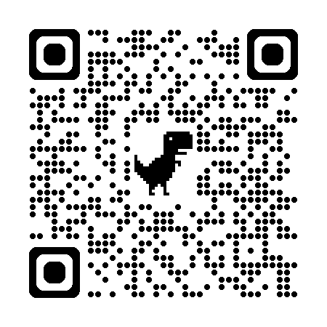
Thank you for your attendance
Further questions or comments?
EPPPcomments@asppb.org
Looking for the most recent news about the EPPP?
https://asppb.net/news-category/eppp-communications/

